Slide 1
Simplifying Logic Circuit

Slide 2
3-10 Boolean Theorems
The theorems or laws that follow may represent an expression containing more than one variable.

Slide 3
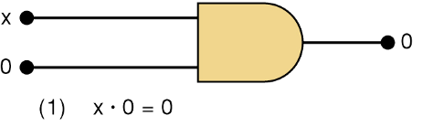
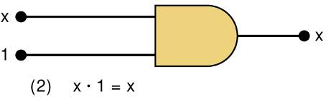
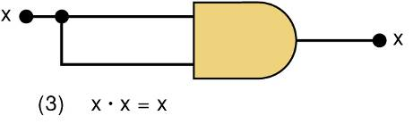
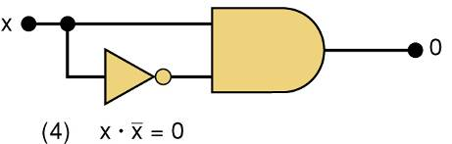
3-10 Boolean Theorems
Theorem (1) states that if any variable is ANDed with 0, the result must be 0.
Theorem (2) is also obvious by comparison with ordinary multiplication.
Prove Theorem (3) by trying each case. If x = 0, then 0 • 0 = 0
If x = 1, then 1 • 1 = 1
Thus, x • x = x
Theorem (4) can be proved in the same manner.

Slide 4
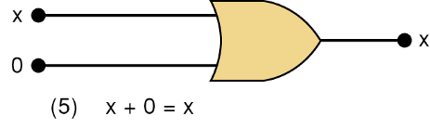
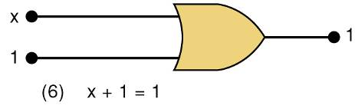
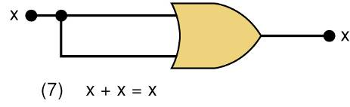
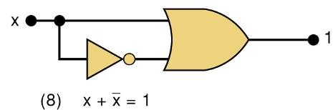
3-10 Boolean Theorems
Theorem (5) is straightforward, as 0 added to anything does not affect value, either in regular addition or in OR addition.
Theorem (6) states that if any variable is ORed with 1, the is always 1.
Check values: 0 + 1 = 1 and 1 + 1 = 1.
Theorem (7) can be proved by checking for both values of x: 0 + 0 = 0 and 1 + 1 = 1.
Theorem (8) can be proved similarly.

Slide 5
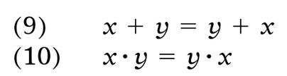


3-10 Boolean Theorems
Multivariable Theorems
Commutative laws
Associative laws
Distributive law

Slide 6
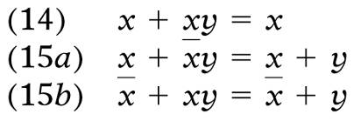
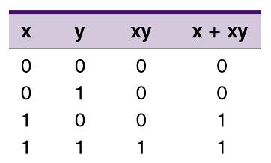

3-10 Boolean Theorems
Theorems (14) and (15) do not have counterparts in ordinary algebra. Each can be proved by trying all possible cases for x and y.
Analysis table & factoring for Theorem (14)

Slide 7
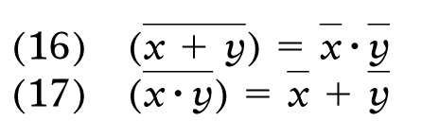
3-11 DeMorgan’s Theorems
DeMorgan’s theorems are extremely useful in simplifying expressions in which a product or sum of variables is inverted.
Theorem (16) says inverting the OR sum of two variables is the same as inverting each variable individually, then ANDing the inverted variables.
Theorem (17) says inverting the AND product of two variables is the same as inverting each variable individually and then ORing them.
Each of DeMorgan’s theorems can readily be proven by checking for all possible combinations of x and y.

Slide 8
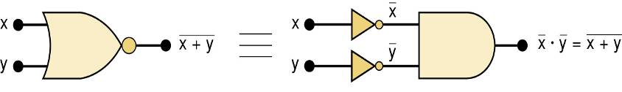
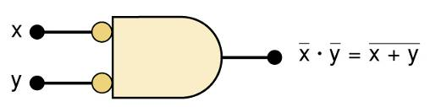
3-11 DeMorgan’s Theorems
Equivalent circuits implied by Theorem (16)
The alternative symbol for the NOR function.

Slide 9
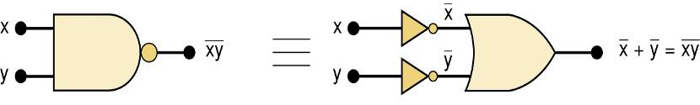
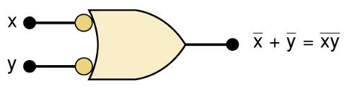
3-11 DeMorgan’s Theorems
Equivalent circuits implied by Theorem (17)
The alternative symbol for the NAND function.

Slide 10
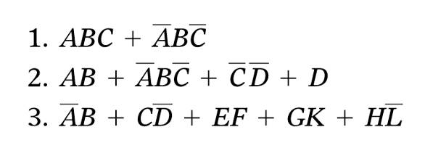
4-1 Sum-of-Products Form
A Sum-of-products (SOP) expression will appear as two or more AND terms ORed together.

Slide 11
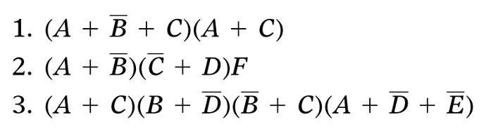
4-1 Sum-of-Products Form
The product-of-sums (POS) form consists of two or more OR terms (sums) ANDed together.

Slide 12
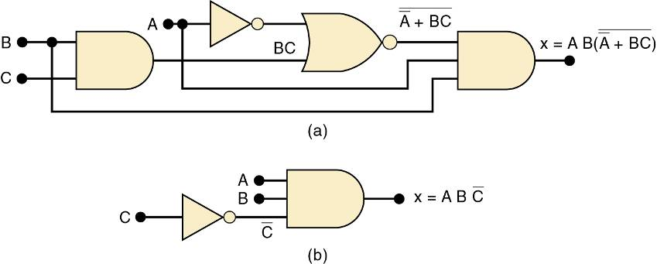
4-2 Simplifying Logic Circuits
The circuits shown provide the same output
Circuit (b) is clearly less complex.
Logic circuits can be simplified using Boolean algebra and Karnaugh mapping.

Slide 13
4-3 Algebraic Simplification
Place the expression in SOP form by applying DeMorgan’s theorems and multiplying terms.
Check the SOP form for common factors.
Factoring where possible should eliminate one or more terms.

Slide 14
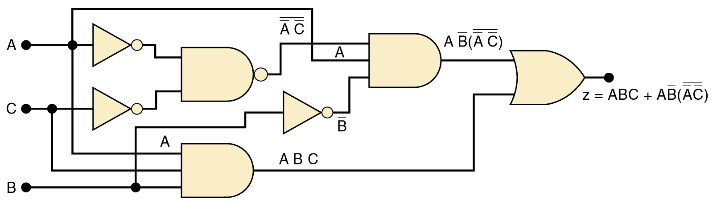
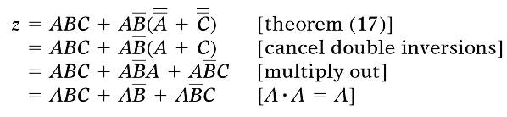
4-3 Algebraic Simplification
Simplify the logic circuit shown.
The first step is to determine the expression for the output:
z = ABC + AB • (A C)
Once the expression is determined, break down large inverter signs by DeMorgan’s theorems & multiply out all terms.

Slide 15


4-3 Algebraic Simplification
Simplify the logic circuit shown.
Factoring—the first & third terms above have AC in common, which can be factored out:
Since B + B = 1, then…
Factor out A, which results in…

Slide 16
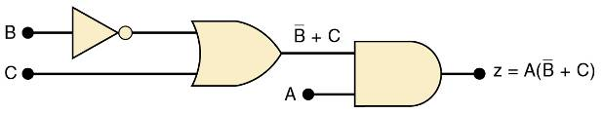
4-3 Algebraic Simplification
Simplified logic circuit.
z = A(C + B)

Slide 17
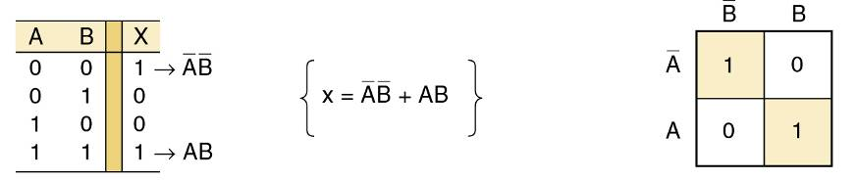
4-5 Karnaugh Map Method
A graphical method of simplifying logic equations or truth tables—also called a K map.
Theoretically can be used for any number of input variables—practically limited to 5 or 6 variables.
The truth table values are placed in the K map. Shown here is a two-variable map.

Slide 18
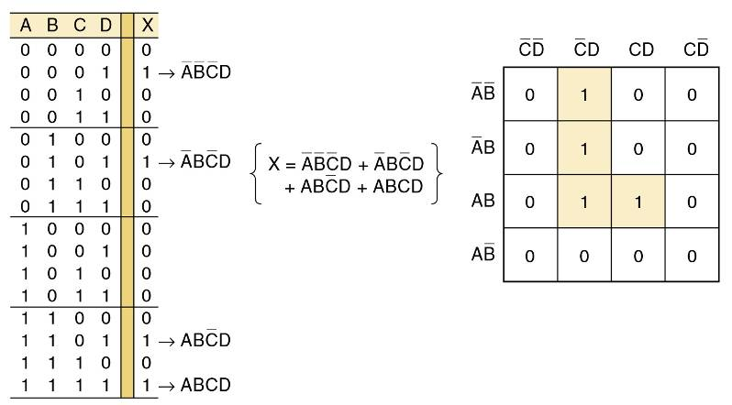
4-5 Karnaugh Map Method
Four-variable K-Map.
Adjacent K map square differ in only one variable both horizontally and vertically.
A SOP expression can be obtained by ORing all squares that contain a 1.

Slide 19
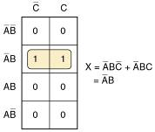
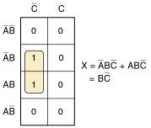
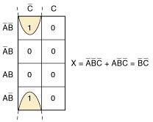
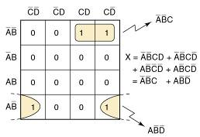
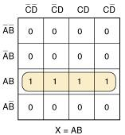
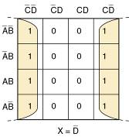
4-5 Karnaugh Map Method
Looping 1s in adjacent groups of 2, 4, or 8 will result in further simplification.
Looping groups of 2 (Pairs)
Groups of 4 (Quads)
Groups of 8 (Octets)

Slide 20
4-5 Karnaugh Map Method
When the largest possible groups have been looped, only the common terms are placed in the final expression.
Looping may also be wrapped between top, bottom, and sides.

Slide 21
4-5 Karnaugh Map Method
Complete K map simplification process:
Construct the K map, place 1s as indicated in the truth table.
Loop 1s that are not adjacent to any other 1s.
Loop 1s that are in pairs.
Loop 1s in octets even if they have already been looped.
Loop quads that have one or more 1s not already looped.
Loop any pairs necessary to include 1st not already looped.
Form the OR sum of terms generated by each loop.
When a variable appears in both complemented and uncomplemented form within a loop, that variable is eliminated from the expression. Variables that are the same for all squares of the loop must appear in the final expression.

